Slide 1
B-Trees

Slide 2
Introduction
B-trees are balanced search trees designed to work well on magnetic disks or other direct-access secondary storage devices.
B-trees are similar to red-black trees, but they are better at minimizing disk I/O operations.
Many database systems use B-trees, or variants of B-trees, to store information.
B-trees differ from red-black trees in that B-tree nodes may have many children, from a handful to thousands.
That is, the “branching factor” of a B-tree can be quite large, although it is usually determined by characteristics of the disk unit used.

Slide 3
Introduction…
Btrees are similar to red-black trees in that every n-node B-tree has height O(lg n),
The height of a B-tree can be considerably less than that of a red-black tree because its branching factor can be much larger.
Therefore, B-trees can also be used to implement many dynamic-set operations in time O(lg n).

Slide 4
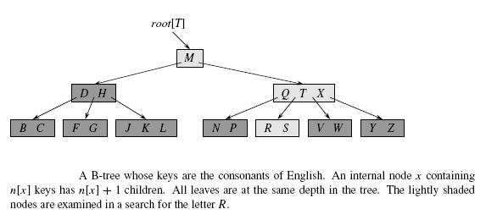
Introduction…

Slide 5
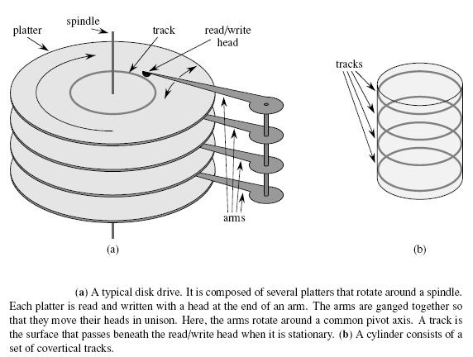
Data structures on secondary storage

Slide 6
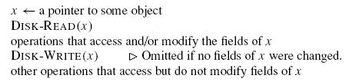
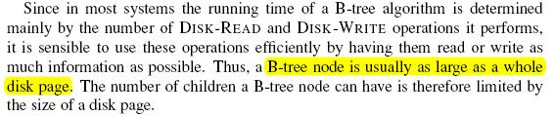
Disk operations

Slide 7
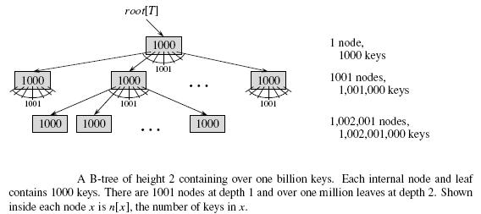
Effect of branching factor on B-tree height

Slide 8
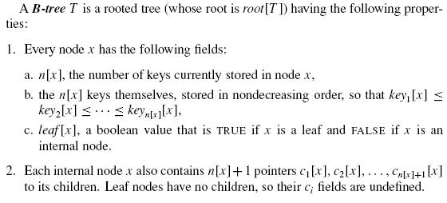
Definition of B-trees

Slide 9
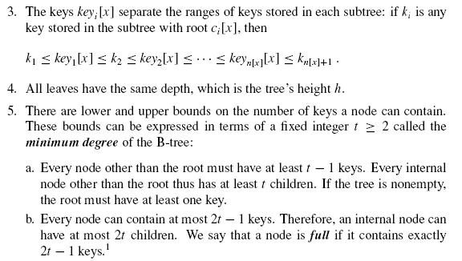
Definition of B-trees…

Slide 10
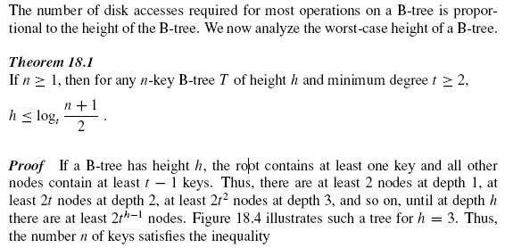
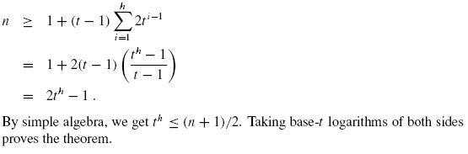
The height of a B-tree

Slide 11
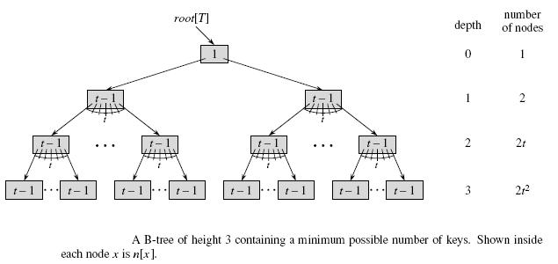
The height of a B-tree…

Slide 12
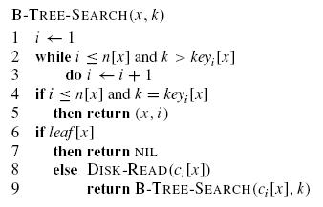
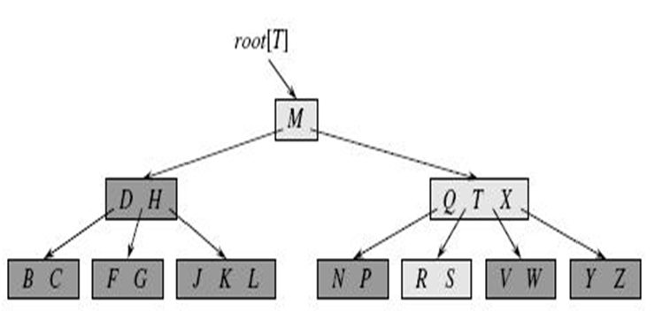
Basic operations on B-trees

Slide 13

Basic operations on B-trees

Slide 14

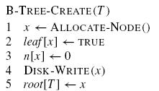
Creating an empty B-tree

Slide 15
Inserting a key into a B-tree
In a B-tree, we cannot simply create a new leaf node and insert it, as the resulting tree would fail to be a valid B-tree.
Here we insert the new key into an existing leaf node.
Since we cannot insert a key into a leaf node that is full, we introduce an operation that splits a full node y (having 2t − 1 keys) around its median key keyt [y] into two nodes having t − 1 keys each.

Slide 16
Inserting a key into a B-tree
But if y’s parent is also full, it must be split before the new key can be inserted, and thus this need to split full nodes can propagate all the way up the tree.
Here we travel down the tree searching for the position where the new key belongs, we split each full node we come to along the way (including the leaf itself).
Thus whenever we want to split a full node y, we are assured that its parent is not full.

Slide 17
Splitting a node in a B-tree
The procedure B-TREE-SPLIT-CHILD takes as input a nonfull internal node x (assumed to be in main memory), an index i , and a node y (also assumed to be in main memory) such that y = ci [x] is a full child of x.
The procedure then splits this child in two and adjusts x so that it has an additional child.
The tree thus grows in height by one; splitting is the only means by which the tree grows.

Slide 18
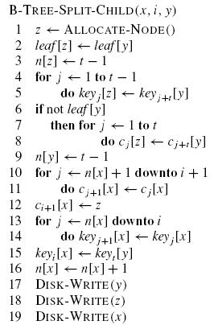
Splitting a node in a B-tree
Here y is the i^{th} child of x
and is the node being split.

Slide 19
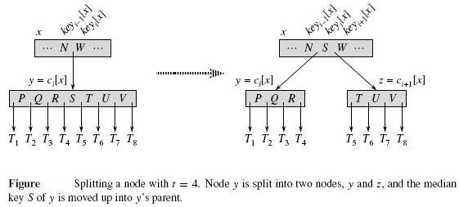

Slide 20
Here Complexity is Θ(t)

Slide 21
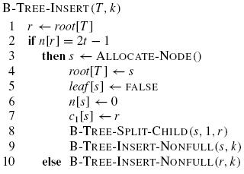
Inserting a key into a B-tree

Slide 22
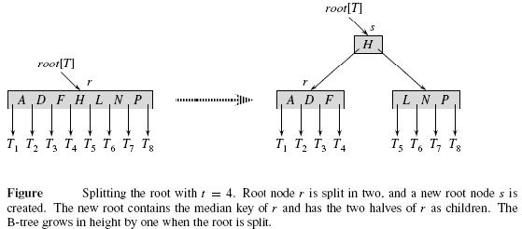
Inserting a key into a B-tree

Slide 23
Procedure B-TREE-INSERT-NONFULL
B-TREE-INSERT-NONFULL is used for insertion of key k in the tree rooted at the nonfull root node.
B-TREE-INSERT-NONFULL recurses as necessary down the tree, at all times guaranteeing that the node to which it recurses is not full by calling B-TREE-SPLIT-CHILD as necessary.
B-TREE-INSERT-NONFULL inserts key k into node x, which is assumed to be nonfull when the procedure is called.

Slide 24
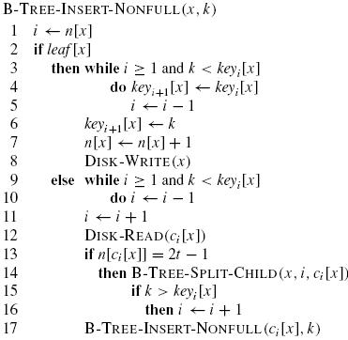
B –tree insertion Example

Slide 25
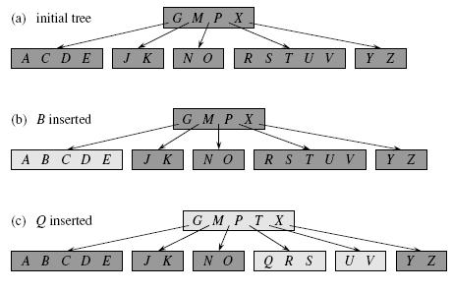
Example of insertion
Inserting keys into a B-tree. The minimum degree t for this B-tree is 3, so a node can
hold at most 5 keys. Nodes that are modified by the insertion process are lightly shaded.

Slide 26
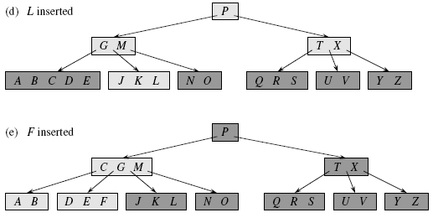
Example of insertion
Inserting keys into a B-tree. The minimum degree t for this B-tree is 3, so a node can
hold at most 5 keys. Nodes that are modified by the insertion process are lightly shaded.

Slide 27
Deleting a key from a B-tree
we must ensure that a node doesn’t get too small during deletion (except that the root is allowed to have fewer than the minimum number t − 1 of keys)
There are different cases in deletion a key in a B-tree.

Slide 28
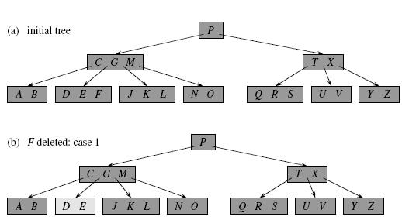
Case1
If the key k is in node x which is a leaf node and number of keys is greater than t-1 ,delete the key k from x.
The minimum degree for this B-tree is t = 3, so a node (other than the root) cannot have fewer than 2 keys. Nodes that are modified are lightly shaded.

Slide 29
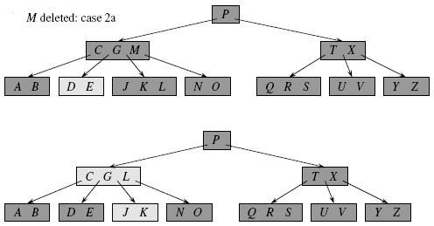
case2: If the key k is in node x and x is an internal node, do the following
a. If the child y that precedes k in node x has at least t keys, then find the predecessor k’ of k in the subtree rooted at y. Recursively delete k’, and replace k by k’ in x.
the predecessor L of M is moved up to take M’s position.

Slide 30
case2: If the key k is in node x and x is an internal node, do the following
b. Symmetrically, if the child z that follows k in node x has at least t keys, then find the successor k’ of k in the subtree rooted at z. Recursively delete k’, and replace k by k’ in x.

Slide 31
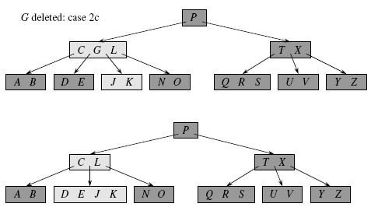
case2: If the key k is in node x and x is an internal node, do the following
c. Otherwise, if both y and z have only t − 1 keys, merge k and all of z into y, so that x loses both k and the pointer to z, and y now contains 2t − 1 keys. Then, free z and recursively delete k from y.

Slide 32
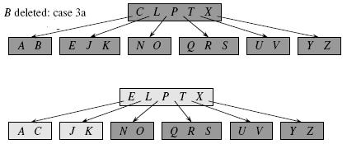
Case 3:If the key k is not present in internal node x, determine the root ci [x] of the appropriate subtree that must contain k, if k is in the tree at all. If ci [x] has only t − 1 keys, execute step 3a or 3b as necessary to guarantee that we descend to a node containing at least t keys. Then, finish by recursing on the appropriate child of x.
a. If ci [x] has only t −1 keys but has an immediate sibling with at least t keys, give ci [x] an extra key by moving a key from x down into ci [x], moving a key from ci [x]’s immediate left or right sibling up into x, and moving the appropriate child pointer from the sibling into ci [x].

Slide 33
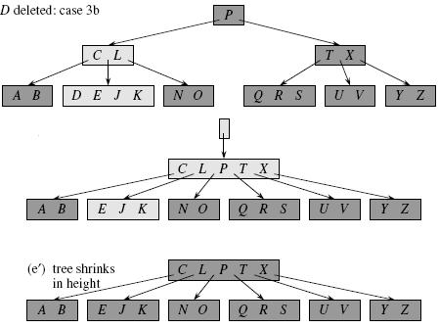
Case 3:If the key k is not present in internal node x, determine the root ci [x] of the appropriate subtree that must contain k, if k is in the tree at all. If ci [x] has only t − 1 keys, execute step 3a or 3b as necessary to guarantee that we descend to a node containing at least t keys. Then, finish by recursing on the appropriate child of x.
b. If ci [x] and both of ci [x]’s immediate siblings have t − 1 keys, merge ci [x] with one sibling, which involves moving a key from x down into the new merged node to become the median key for that node.

